Slide 1
Deep Learning Approach for predicting Protein-Ligand Pair
Name: Chenxi Zhang
Peer Editor: Siqi Tian
Yifan Song
Ruimeng Zhou

Slide 2
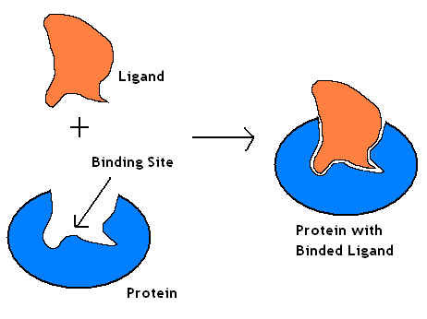
Introduction
The protein-ligand complex is a reversible non-covalent interaction between two biological molecules
The molecules (protein and ligand) recognize each other also by stereospecificity i.e. by the form of the two molecules
In protein-ligand binding, the ligand is usually a molecule which produces a signal by binding to a site on a target protein
The binding typically results in a change of conformational conformation of the target protein
In this project, we are required to develop and train a neural network that takes in the x, y, z coordinates of atoms and the atom types of each protein and the ligand to predict if they can bind or not

Slide 3
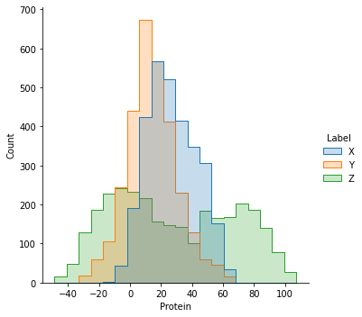
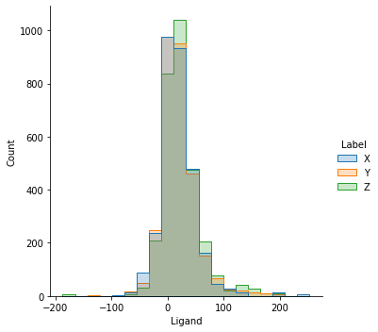
Data Pre-processing
Problem: Inconsistent Input Size
X, Y, Z not in the same scale
Number of atoms inconsistent
Solution: Voxelization
Protein Atoms
Hydrophobic
Normalize to the same scale by using the mean of Ligand in each pair
Map to the 3D Grid (Distance = 40)
Crop the Atom outside the 3D Grid
Ligand Atoms
Polar

Slide 4
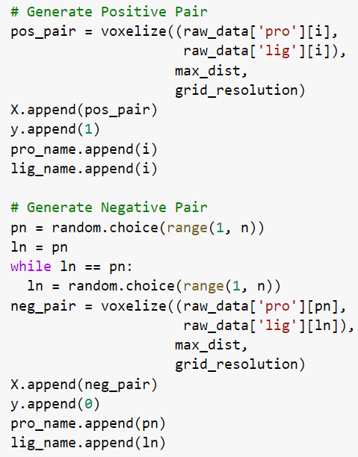
Random Over-sampling
Problem:
Dataset Only consist Protein-Ligand Valid Pairs (True Case)
We also need Invalid Protein-Ligand Pairs (False Case)
Solution:
Randomly add a pair of Protein and Ligand with different name to dataset
Final Dataset:
Training: 2690 pairs
Validation: 1330 pairs
Testing: 1980 pairs

Slide 5
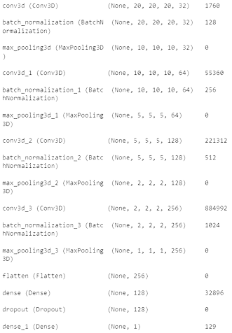
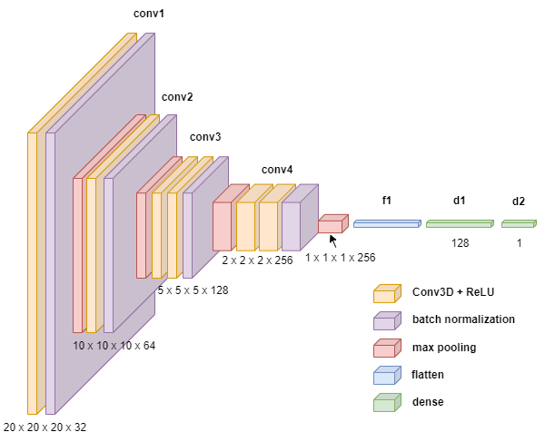
CNN Model

Slide 6
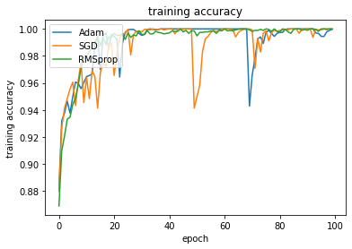
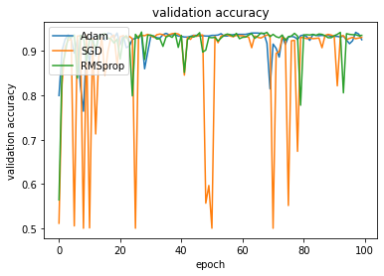
Experimental Study: Optimizer

Slide 7
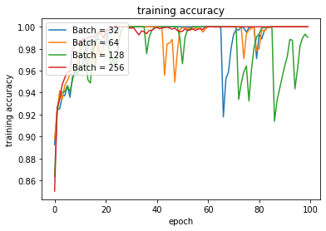
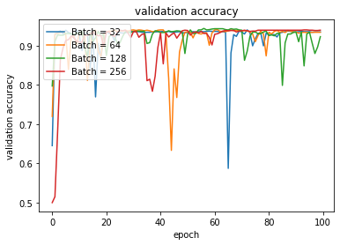
Experimental Study: Batch Size

Slide 8
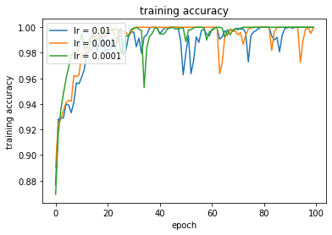
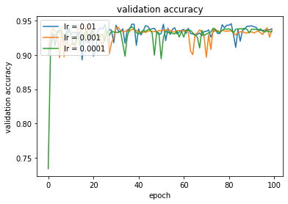
Experimental Study: Learning Rate

Slide 9
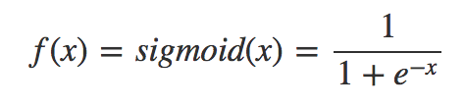
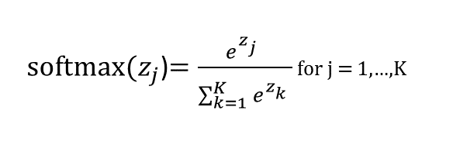
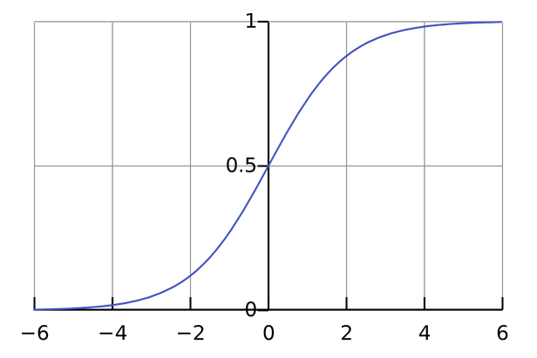
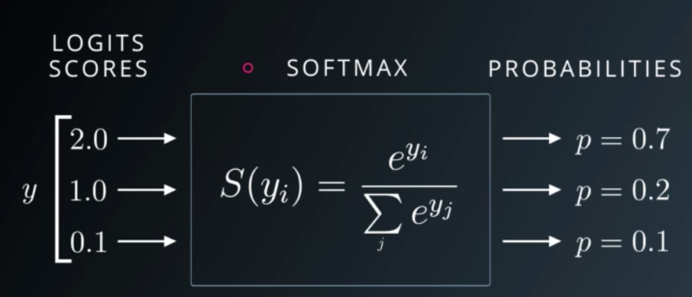
Sigmoid vs. Softmax
For small values (<-5), sigmoid returns a value close to zero, and for large values (>5) the result of the function gets close to 1
Sigmoid is equivalent to a 2-element Softmax, where the second element is assumed to be zero
Softmax is used for multi-classification
Sigmoid is used for binary classification

Slide 10
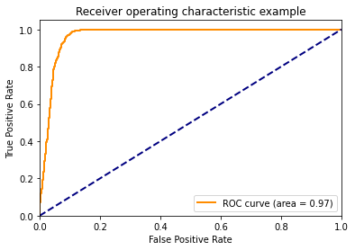
Model Summary
Parameters
Construction | Training | Validating
Epochs: 10 ~ 20 | Last Layer Activation Function: Sigmoid | Loss Function: Binary Crossentropy
Batch Size: 32 | Optimizers & Learning Rate: Adam(0.01) | Metrics: val_acc
Model Performance
 | Predicted
 | 0 | 1
0 | 915 | 75
1 | 42 | 948
 | Precision | Recall | F1
Negative Pair | 0.96 | 0.92 | 0.94
Positive Pair | 0.93 | 0.96 | 0.94
Accuracy | 0.94
Actual

Slide 11
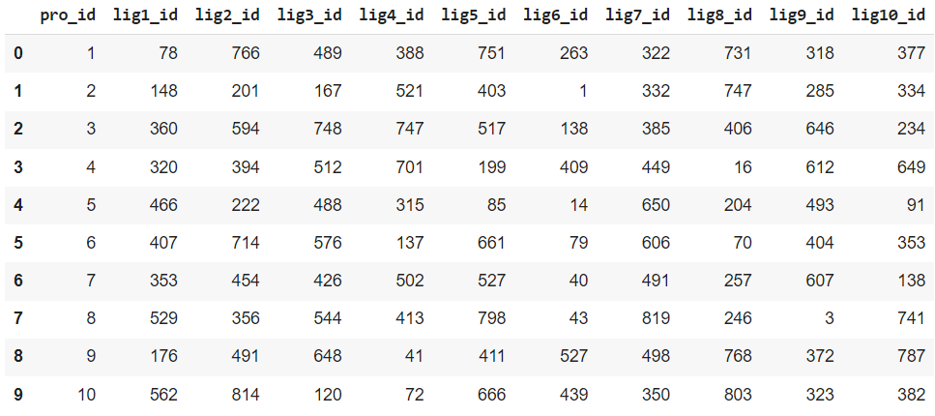
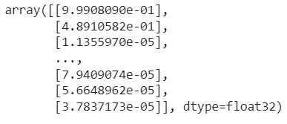
Prediction
Test Set: 824 * 824 pairs of Protein-Ligand

Slide 12
Thanks!
Any questions?

